Slide 1













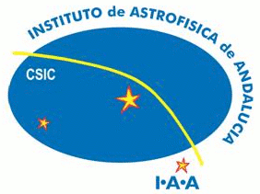







What can provenance do for me?
Stian Soiland-Reyes
myGrid, University of Manchester
This work is licensed under a
Creative Commons Attribution 3.0 Unported License
Ocean Sampling Day planning Bremen 2013-03-21

Slide 2
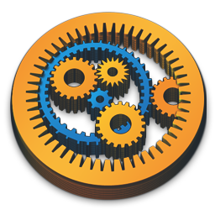



Provenance of Stian Soiland-Reyes
Developer/researcher in myGrid team, School of Computer Science, University of Manchester since 2006
Involved with:
Taverna - Scientific workflow system
myExperiment – sharing workflows and artefacts
Wf4Ever - digital preservation (of workflows and workflow runs)
W3C Provenance WG – standards for describing provenance
Open Annotation – standard for tracking who said what about something
http://soiland-reyes.com/stian/work/

Slide 3
Overview
What is provenance?
Attribution
Derivation
Activities
PROV model
Aggregating and sharing
Why you want provenance

Slide 4
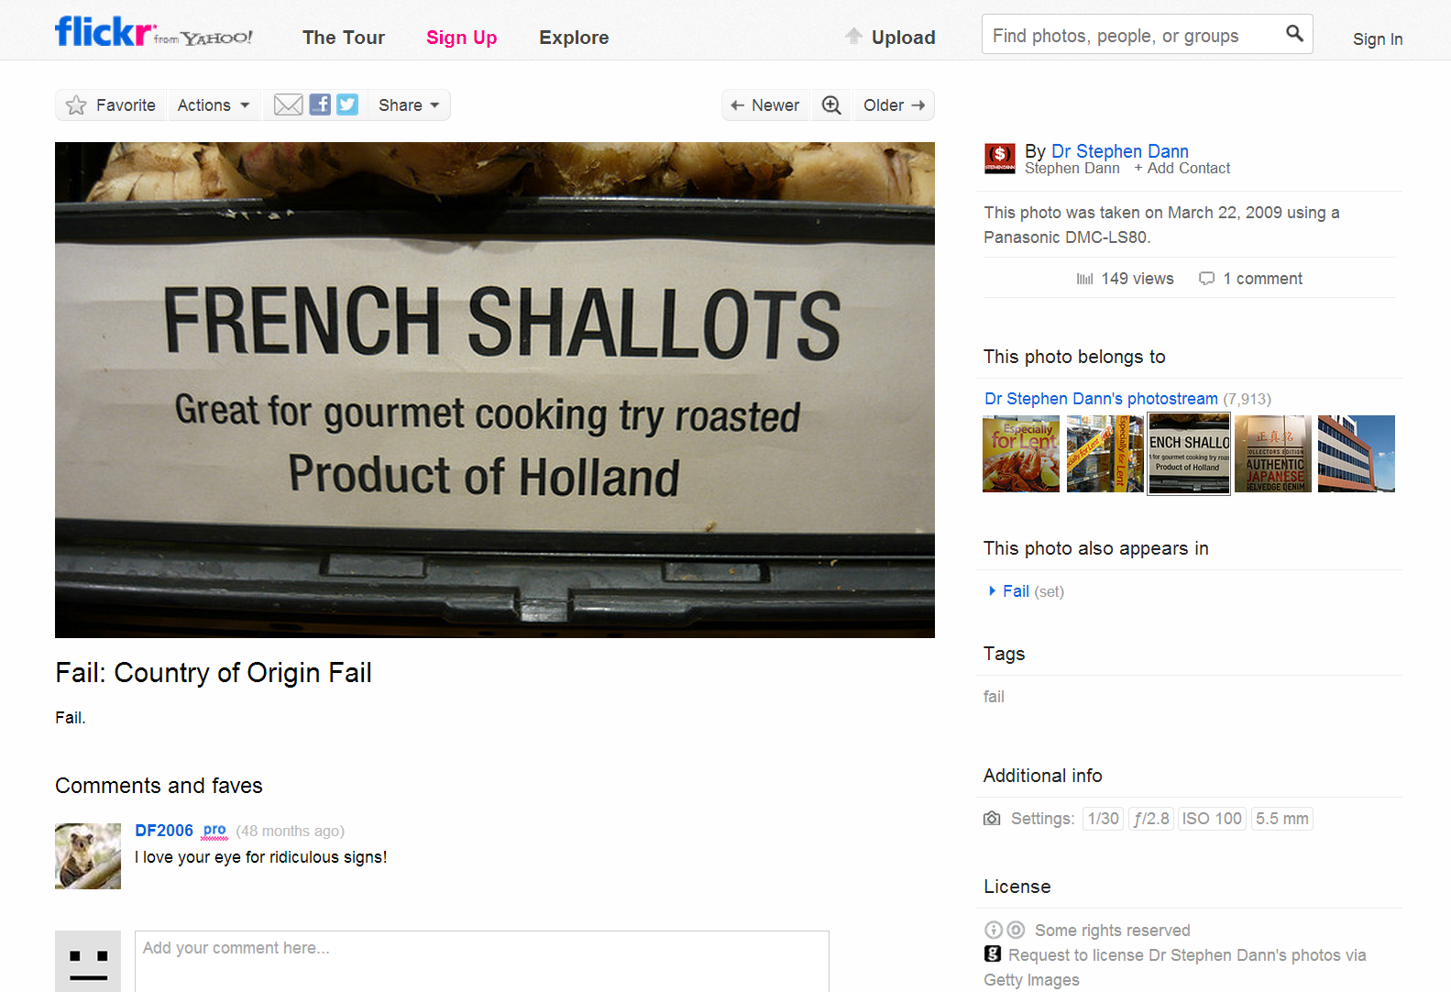
What is provenance?
Attribution who did it?
Abstraction levels shallots, sign, photo or flickr page?
Activity what happens to it?
Date and tool when was it made?
using what?
Derivation how did it change?
Origin where is it from?
Aggregation what is it part of?
Annotations what do others say about it?
Attributes what is it?
Licensing can I use it?
By Dr Stephen Dann licensed under Creative Commons Attribution-ShareAlike 2.0 Generic http://www.flickr.com/photos/stephendann/3375055368/

Slide 5
Attribution
Who collected this sample? Who helped?
Which lab performed the sequencing?
Who did the data analysis?
Who curated the results?
Who produced the raw data this analysis is based on?
Who wrote the analysis workflow?
Why do I need this?
To be recognized for my work
Who should I give credits to?
Who should I complain to?
Can I trust them?
Who should I make friends with?
actedOnBehalfOf
Alice
The lab
wasAttributedTo
Data
Agent types
Roles
prov:wasAttributedTo
prov:actedOnBehalfOf dct:creator dct:publisher pav:authoredBy pav:contributedBy pav:curatedBy pav:createdBy pav:importedBy pav:providedBy
...
Person Organization SoftwareAgent

Slide 6
Derivation
Which sample was this metagenome sequenced from?
Which meta-genomes was this sequence extracted from?
Which sequence was the basis for the results?
What is the previous revision of the new results?
Why do I need this?
To verify consistency (did I use the correct sequence?)
To find the latest revision
To backtrack where a diversion appeared after a change
To credit work I depend on
Auditing and defence for peer review
Sample
wasDerivedFrom
Meta -genome
wasQuotedFrom
Sequence
wasInfluencedBy
wasDerivedFrom
Old results
wasRevisionOf
New results

Slide 7
Activities
Lab technician
Alice
Sample
hadRole
wasAssociatedWith
used
What happened? When? Who?
What was used and generated?
Why was this workflow started?
Which workflow ran? Where?
Why do I need this?
To see which analysis was performed
To find out who did what
What was the metagenome used for?
To understand the whole process “make me a Methods section”
To track down inconsistencies
Sequencing
"2012-06-21"
wasStartedAt
wasGeneratedBy
wasInformedBy
Metagenome
Workflow server
wasStartedBy
wasAssociatedWith
Workflow run
hadPlan
wasGeneratedBy
Workflow definition
Results
Results
Notes:
Sequencing machines: illumina

Slide 8

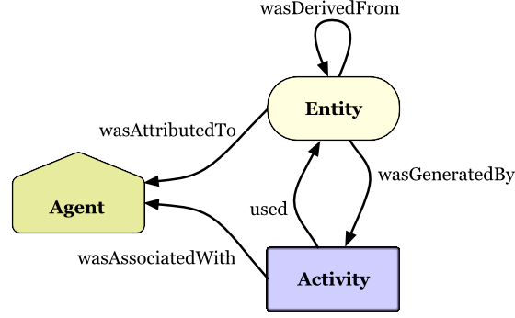
Core PROV model
Provenance Working Group
Copyright © 2013 W3C® (MIT, ERCIM, Keio, Beihang), All Rights Reserved.
http://www.w3.org/TR/prov-primer/
Agent
Entity
Activity
wasDerivedFrom
Notes:
W3C standardisation body HTML

Slide 9
How to find provenance data
resource
provenance
has_provenance
Tracking provenance data
Querying provenance “What was derived from X?”
Pingback of provenance “Here’s new provenance data about X”
Why do I need this?
To propagate provenance data (e.g. when integrating data)
To include external provenance (e.g. for reference datasets)
To avoid black-box provenance (e.g. in workflows)
To merge provenance at different abstraction levels
To see what has used the data (“Has someone done the analysis?”)
has_query_service
Provenance service
http://www.w3.org/TR/prov-aq/

Slide 10
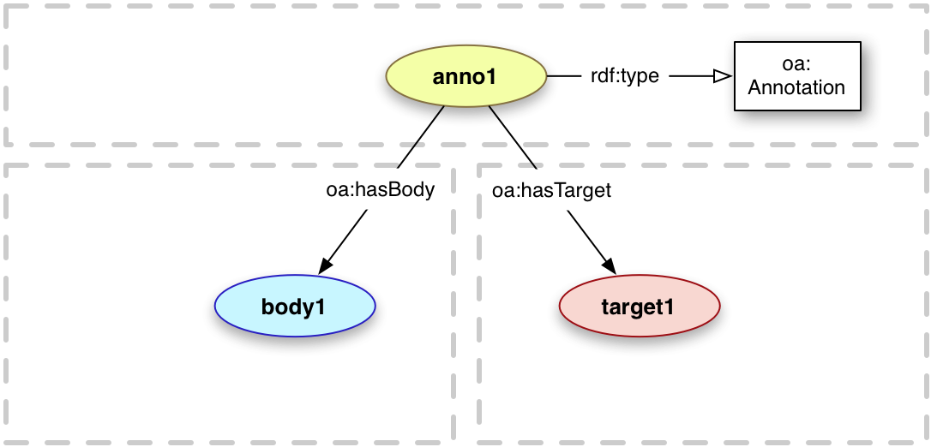
Let’s talk about it
Open Annotation Data Model
Copyright © 2012-2013 the Contributors to the Open Annotation Core Data Model Specification, published by the Open Annotation Community Group under the W3C Community Contributor License Agreement (CLA).
The body is somewhat about or related to the target
Provenance: Who said that? When? Why?
E.g. describing, commenting, highlighting, bookmarking, tagging, classifying, identifying
http://www.openannotation.org/spec/core/

Slide 11

Gathering everything
Research Objects (RO) aggregate related resources, their provenance and annotations
Conveys “everything you need to know” about a study/experiment/analysis/dataset/workflow
Shareable, evolvable, contributable, citable
ROs have their own provenance and lifecycles
Hypothesis
Provenance
Research
Object
Raw data
aggregates
Workflow
Annotations
Analysis tools
Results
http://purl.org/wf4ever/model
Paper
Reference literature
Notes:
http://purl.org/wf4ever/model

Slide 12
Research Objects
Hypothesis
Provenance
Research
Object
Raw data
aggregates
Annotations
Workflow
Analysis tools
Results
Paper
Reference literature
Why do I need them?
To share your research materials (RO as a social object)
To facilitate reproducibility and reuse of methods
To be recognized and cited (even for constituent resources)
To preserve results and prevent decay (curation of workflow definition; using provenance for partial rerun)
Notes:
http://purl.org/wf4ever/model

Slide 13
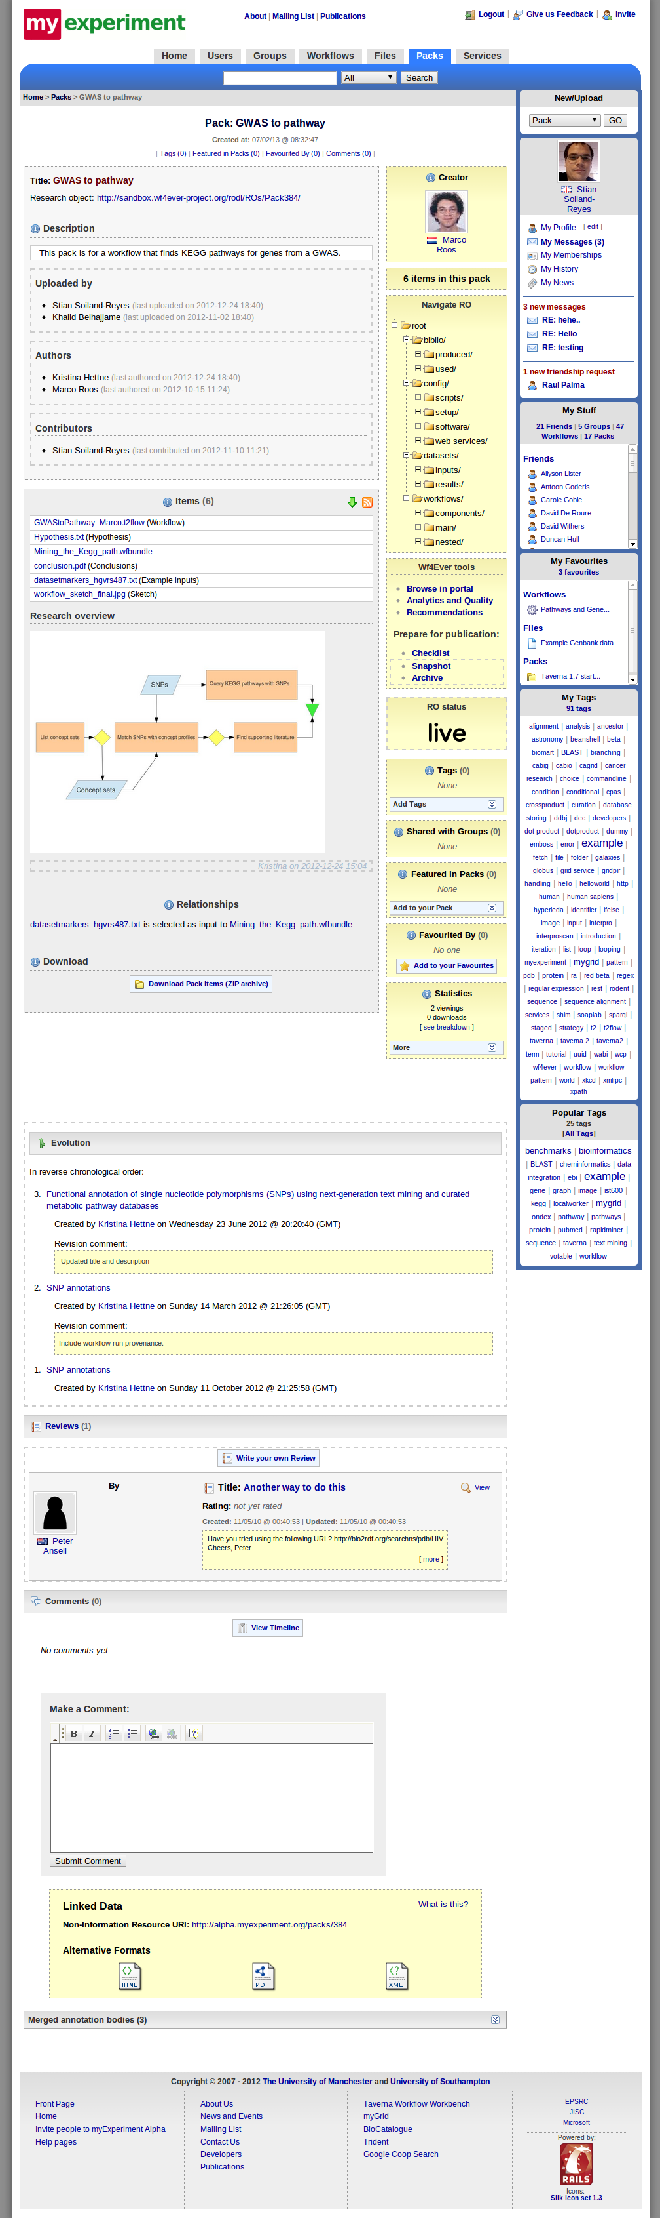
myExperiment Research Objects

Slide 14
Why you want provenance
To acknowledge sources you have based your work on
Receive credit when others uses your work
Build trust (who did it?) and verify consistency (was it done correctly?)
To audit and defend for peer review
Keep track of resources that change over time (versioning)
Investigate and compare data (where did that strange value come from?)
Gather everything you need for that Methods section
Facilitate reproducibility by tracking activities and their outcomes
To prevent decay by aggregating related resources and their descriptions

Slide 15
Thank you
Questions? Twitter: @soilandreyes Skype: soiland http://soiland-reyes.com/stian/work/
http://www.wf4ever-project.org/

